Slide 1


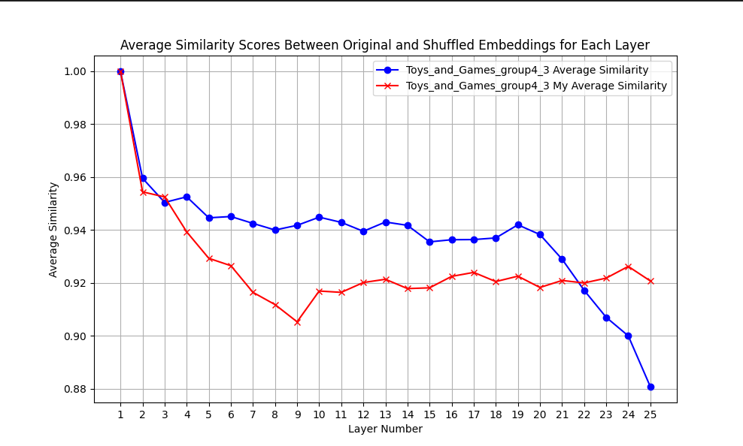
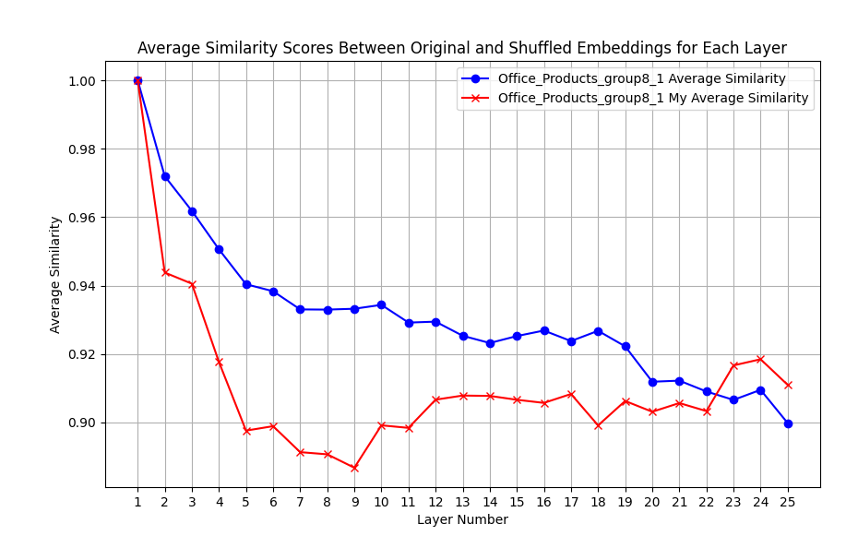
ATAI
Advanced Technique of
Artificial Intelligence
ATAI
ChongqingUniversity _{AdvancedTechniqueof}
of Technology Artificial Intelligence
Chongqing University of Technology
Motivation

Slide 2


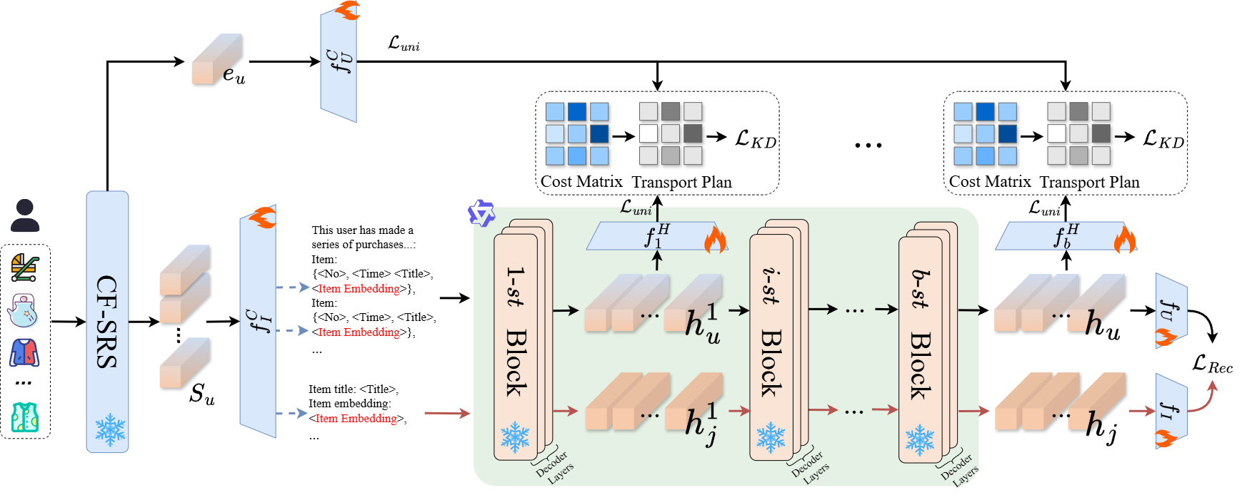
ATAI
Advanced Technique of Artificial Intelligence
ATAI
ChongqingUniversity _{AdvancedTechniqueof}
of Technology Artificial Intelligence
Chongqing University of Technology
Chongqing University ^{ATAI}
_{of Technology} Advanced Techniqueof
Artificial Intelligence
Chongqing University of Technology
Chongqing University of Technology

Slide 3
ATAI
Advanced Technique of Artificial Intelligence
ATAI
ChongqingUniversity _{AdvancedTechniqueof}
of Technology Artificial Intelligence
Chongqing University of Technology
Chongqing University ^{ATAI}
_{of Technology} Advanced Techniqueof
Artificial Intelligence
Chongqing University of Technology
Chongqing University of Technology
N10
H10
N20
H20
Baby
LLM-SRec
0.13954
0.239804
0.161082
0.369519
Ours
0.152697
0.26035
0.174717
0.391598
Arts
LLM-SRec
0.289961
0.4803
0.315238
0.6306
Ours
0.309826
0.497533
0.334722
0.6446
Office
LLM-SRec
0.18863
0.327653
0.213766
0.476452
Ours
0.21273
0.359685
0.237711
0.508778
Toys
LLM-SRec
0.21106
0.38304
0.251636
0.54422
Ours
0.229624
0.40606
0.269013
0.56252

Slide 4
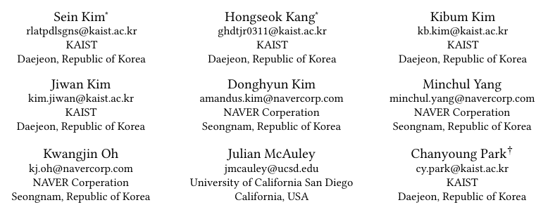





ATAI
Advanced Technique of Artificial Intelligence
ATAI
ChongqingUniversity _{AdvancedTechniqueof}
of Technology Artificial Intelligence
Chongqing University of Technology
Chongqing University ^{ATAI}
_{of Technology} Advanced Techniqueof
Artificial Intelligence
Chongqing University of Technology
Chongqing University of Technology
Lost in Sequence: Do Large Language Models Understand
Sequential Recommendation?
code:https://github.com//LLM2Rec
—— KDD’25
Reported by Jinfei Chen
1

Slide 5
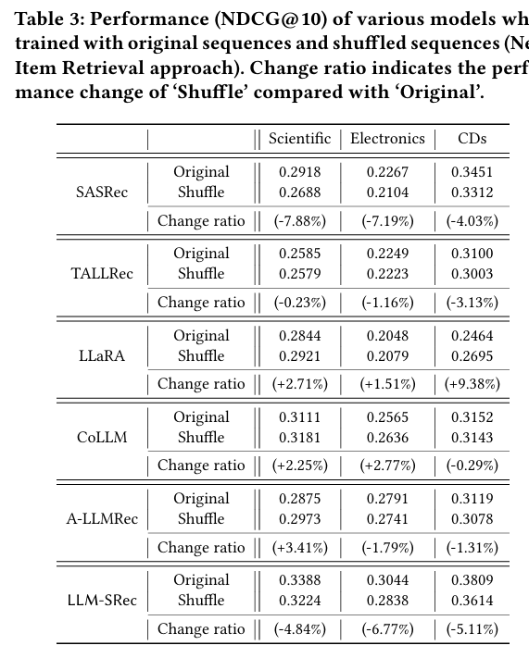
ATAI
Advanced Technique of
Artificial Intelligence
ATAI
ChongqingUniversity _{AdvancedTechniqueof}
of Technology Artificial Intelligence
Chongqing University of Technology
Motivation
Despite the current practice of training and evaluating LLM-based recommendation (LLM4Rec) models under a sequential recommendation scenario, we found that whether these models understand the sequential information inherent in users’ item interaction sequences has been largely overlooked. In this paper, we first demonstrate through a series of experiments that existing LLM4Rec models do not fully capture sequential information both during training and inference.

Slide 6
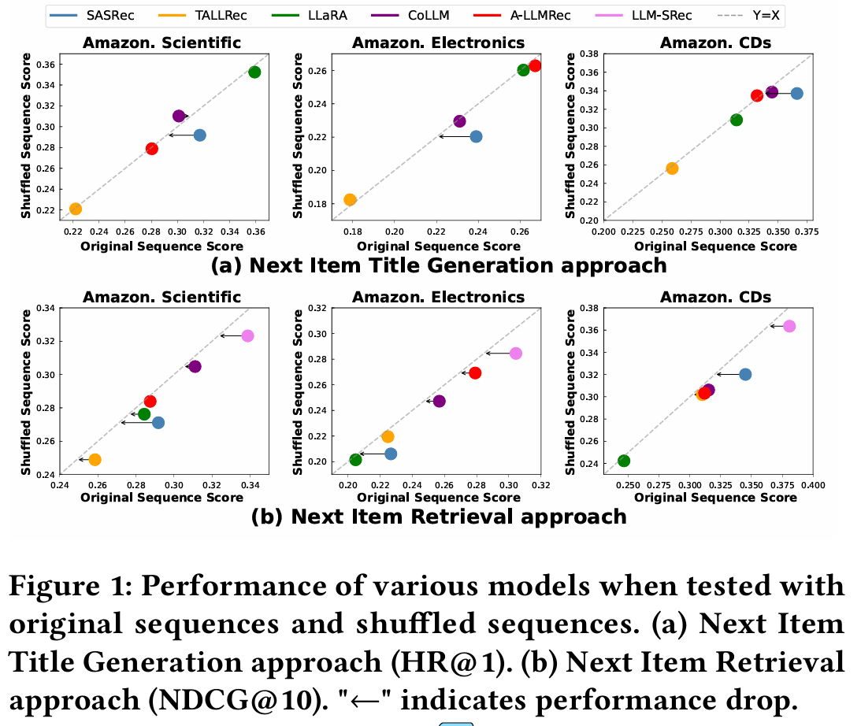
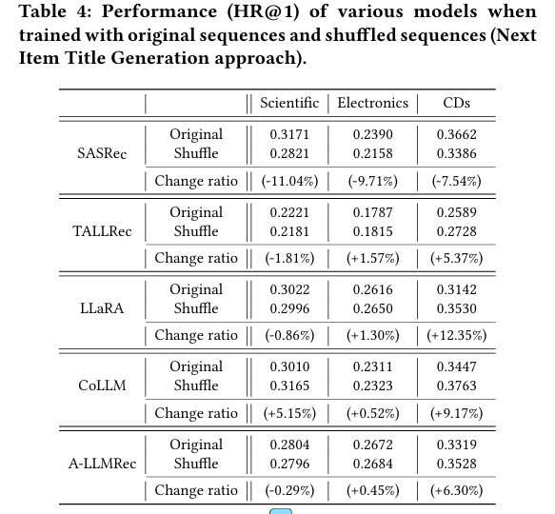
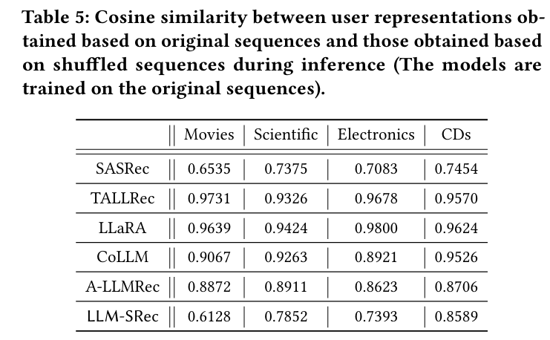
ATAI
Advanced Technique of
Artificial Intelligence
ATAI
ChongqingUniversity _{AdvancedTechniqueof}
of Technology Artificial Intelligence
Chongqing University of Technology
Motivation

Slide 7
ATAI
Advanced Technique of
Artificial Intelligence
ATAI
ChongqingUniversity _{AdvancedTechniqueof}
of Technology Artificial Intelligence
Chongqing University of Technology
Motivation

Slide 8
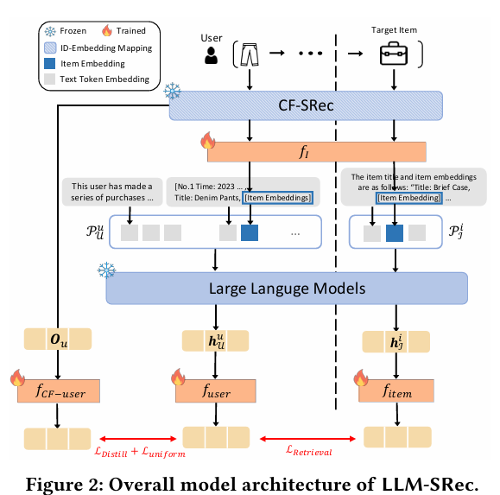
ATAI
Advanced Technique of
Artificial Intelligence
ATAI
ChongqingUniversity _{AdvancedTechniqueof}
of Technology Artificial Intelligence
Chongqing University of Technology
Overview

Slide 9



ATAI
Advanced Technique of
Artificial Intelligence
ATAI
ChongqingUniversity _{AdvancedTechniqueof}
of Technology Artificial Intelligence
Chongqing University of Technology
Method

Slide 10
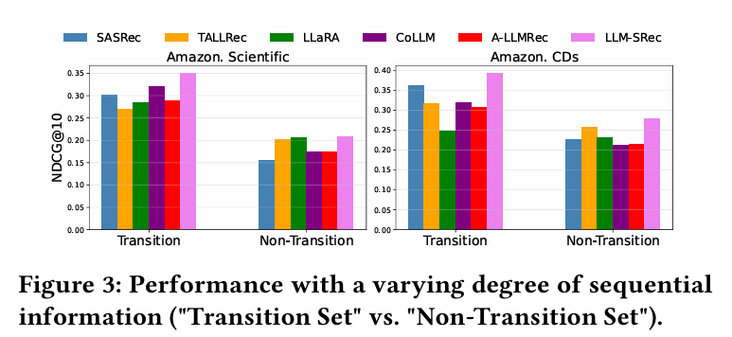
ATAI
Advanced Technique of
Artificial Intelligence
ATAI
ChongqingUniversity _{AdvancedTechniqueof}
of Technology Artificial Intelligence
Chongqing University of Technology
Experiments

Slide 11
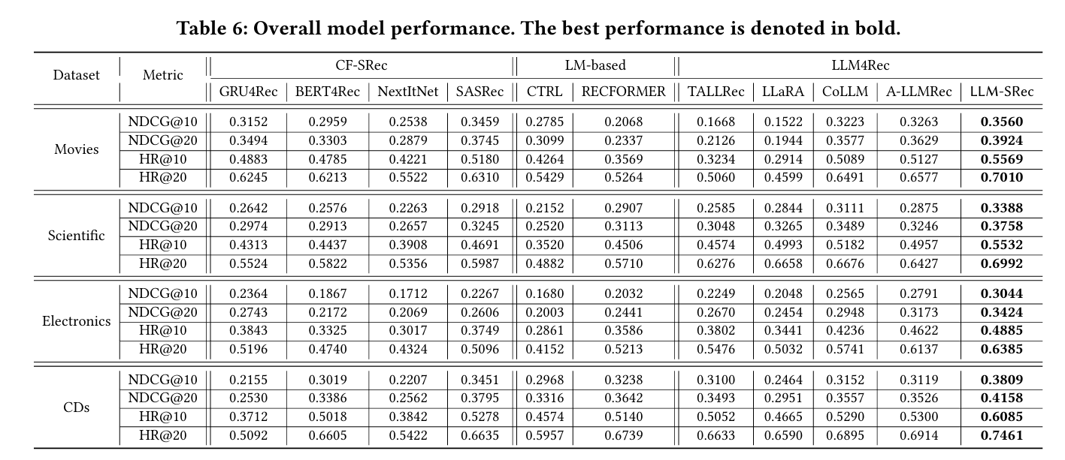
ATAI
Advanced Technique of
Artificial Intelligence
ATAI
ChongqingUniversity _{AdvancedTechniqueof}
of Technology Artificial Intelligence
Chongqing University of Technology
Experiments

Slide 12
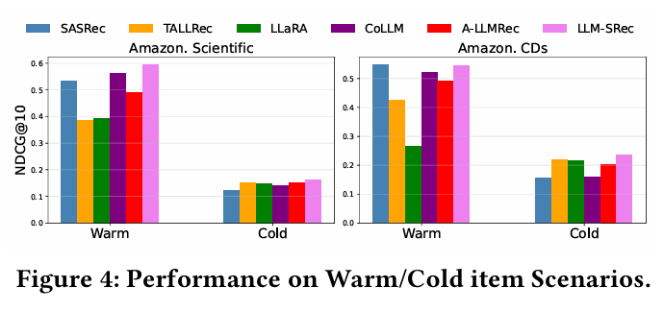
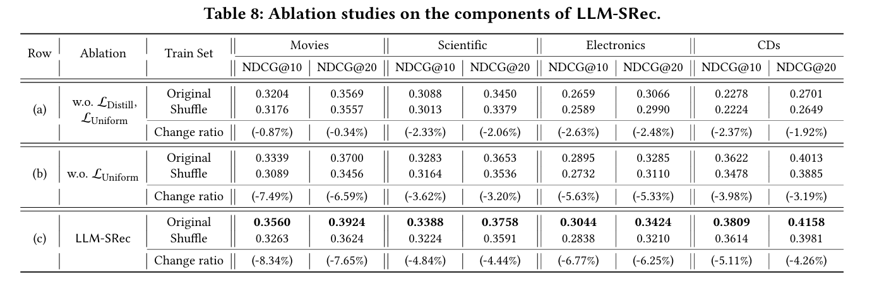
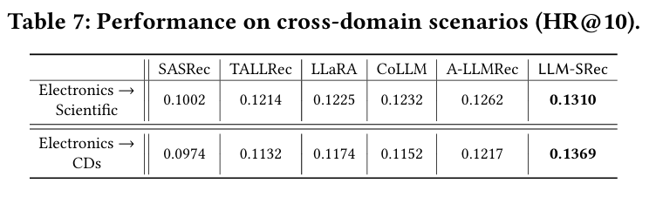
ATAI
Advanced Technique of
Artificial Intelligence
ATAI
ChongqingUniversity _{AdvancedTechniqueof}
of Technology Artificial Intelligence
Chongqing University of Technology
Experiments

Slide 13
ATAI
Advanced Technique of
Artificial Intelligence
ATAI
ChongqingUniversity _{AdvancedTechniqueof}
of Technology Artificial Intelligence
Chongqing University of Technology
Experiments

Slide 14
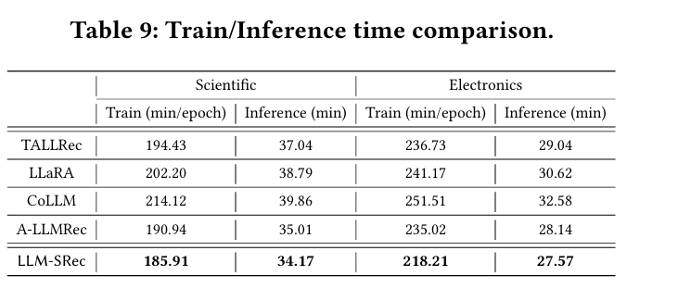
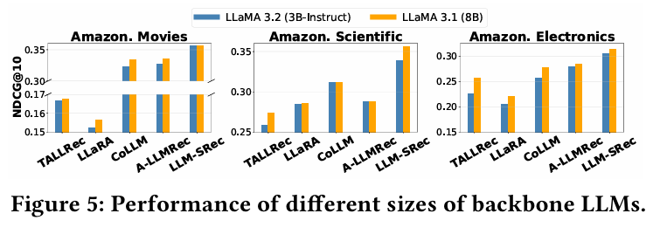
ATAI
Advanced Technique of
Artificial Intelligence
ATAI
ChongqingUniversity _{AdvancedTechniqueof}
of Technology Artificial Intelligence
Chongqing University of Technology
Experiments

Slide 15
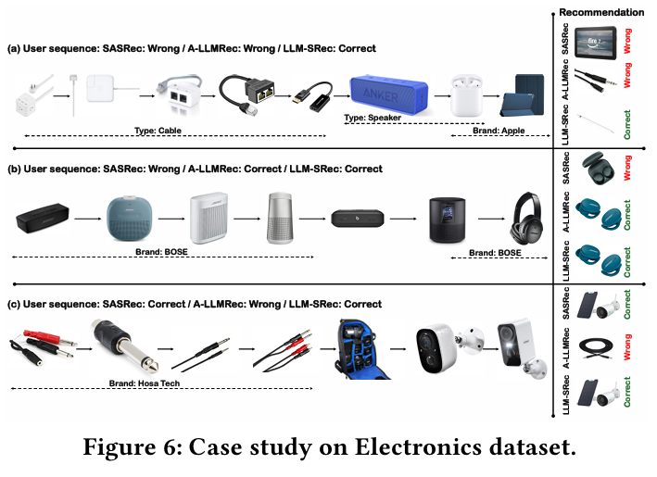
ATAI
Advanced Technique of
Artificial Intelligence
ATAI
ChongqingUniversity _{AdvancedTechniqueof}
of Technology Artificial Intelligence
Chongqing University of Technology
Experiments

Slide 16


ATAI
Advanced Technique of
Artificial Intelligence
ATAI
ChongqingUniversity _{AdvancedTechniqueof}
of Technology Artificial Intelligence
Chongqing University of Technology
Thanks!

